Slide 1
What is Talaash?
How it can be beneficial to users?

Slide 2
Talaash is a very helpful tool to track and find lost subjects such as Pets, objects and humans.
It will provide an interactive user interface to register and keep track everything you care for.

Slide 3
Integration of Talaash with IOT
Talaash has been integrated with following physical IOT components:
T-TOE: For humans
T-TAG: For objects
T-TAME: For pets

Slide 4
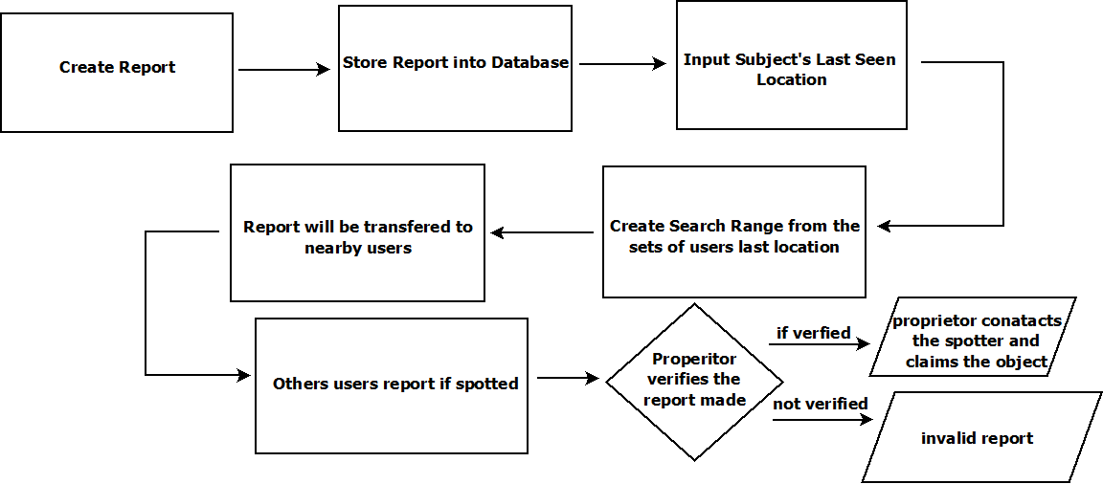
Working Block Diagram

Slide 5
Working of Talaash Application
1) First Create Report
2) Report will be stored into database
3) Talaash will ask the creator of the report to enter the last seen location of the subject they are reporting for
4) Talaash will form the search ranges through the reported locations and inform the nearby users about the reported subject and if they encounter any reported subject.
5) Other users will report if they have found the reported missing subject.
6) Proprietor will verify the report and if it is verified they can claim the missing subject.

Slide 6
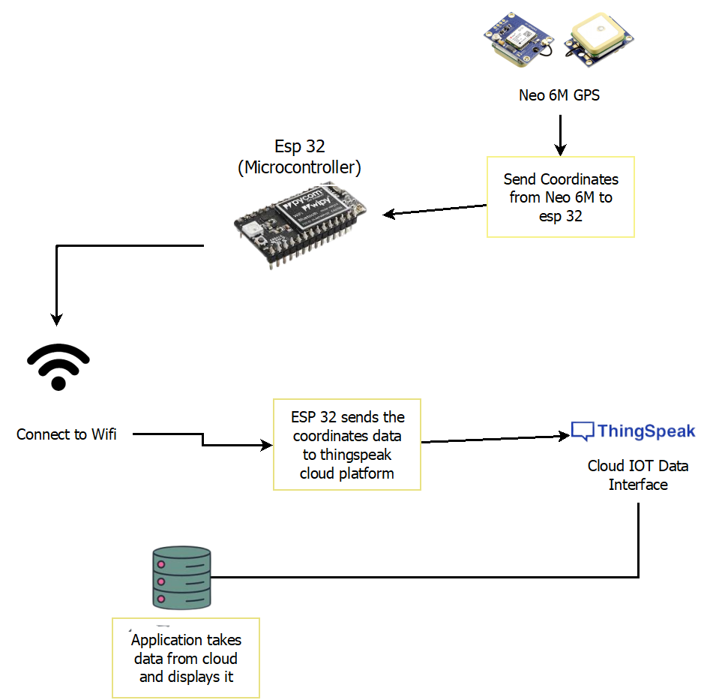
Trackers Block Diagram

Slide 7
Future plans for Talaash
Creating Mobile application for Talaash.
Supporting the government to interact on wanted, missing or escaped subjects (Criminals, lost objects, etc) reports.
Minimizing the size of our physical tackers.
With improved UI and UX TALAASH will be offering features like Voice search, Biometric scanning for user verification and etc.
Enable Camera feed with T-Toe, embed T-Tame with Temperature sensors and SPo2 Sensors to keep track of the health of your pets from large distances.
Our product T-Toe is an initiative towards empowering women and child safety which comes with an additional SOS button and live camera feed when the SOS is triggered.
We’re going to integrate our T-Tag with vehicles to report when any unfortunate case happens.

